Slide 1

Machine Learning Day 2 - Session 2
By AI and ML Track

Slide 2
outlines
Parametric vs Non-parametric models
Classification
Decision Tree
Assessment of classification models
Decision Tree Regression

Slide 3
Parametric and non-parametric models

Slide 4
Parametric Models
E.g. Linear Regression
Parametric methods involve a two-step model-based approach:
First, we make an assumption about the functional form, or shape, of f.
For example, one very simple assumption is that f is linear in X:
f (X) = θ ₀ + θ ₁ X ₁ + θ ₂ X ₂ + ⋯ + θ _{p} X _{p}
After the model is selected, we use a certain procedure to estimate the parameters θ₀, θ₁, ... , θ_{p}. (In linear regression, we estimated these parameters such that a pre-defined loss function J is minimized)

Slide 5
Parametric Models
Advantage:
Assuming a parametric form for f simplifies the problem. It is generally easier to estimate a bounded set of parameters, than it is to fit an entirely arbitrary function f.
Disadvantage:
the model we choose will usually not match the true unknown form of f.
If the chosen model is too far from the true f, then our estimate will be poor.

Slide 6
Non-parametric Models
Non-Parametric models are not characterized by a bounded set of parameters.
Non-parametric methods do not make explicit assumptions about the functional form of f.
Instead, they seek an estimate of f that gets as close to the data points as possible without being too rough or wiggly (let the data speak for themselves rather than forcing them to speak through a tiny vector of parameters).

Slide 7
Non-parametric Models
Advantage:
These approaches have the potential to accurately fit a wider range of possible shapes for f
Good when you have sufficient number of examples and you don’t want to worry about selecting the right features (no prior knowledge).
Disadvantage:
a very large number of observations (typically far more than is typically needed for a parametric approach) is required in order to obtain an accurate estimate for f

Slide 8
Classification
We tend to refer to problems with a quantitative response as regression problems, while those involving a qualitative response are often referred to as classification problems
Classification problems occur often, examples:
An emergency room service that classifies possible medical condition based on a set of symptoms.
An online banking service that classifies if a transaction being is fraudulent based on some user data such as IP address and past transaction history.
An email service that indicates if a received email is spam or not.
Identify which DNA mutations that may cause a give disease and which of these mutations don’t based on DNA sequence data for several patients with and without that disease.

Slide 9
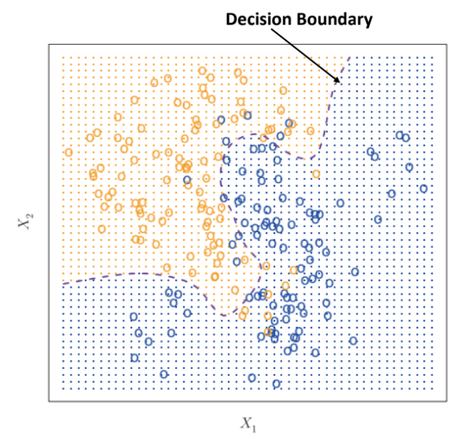
Decision Boundary

Slide 10
Decision Tree
Non-parametric model
One of the simplest and yet most successful forms of machine learning.
Can be applied to both regression and classification problems.

Slide 11
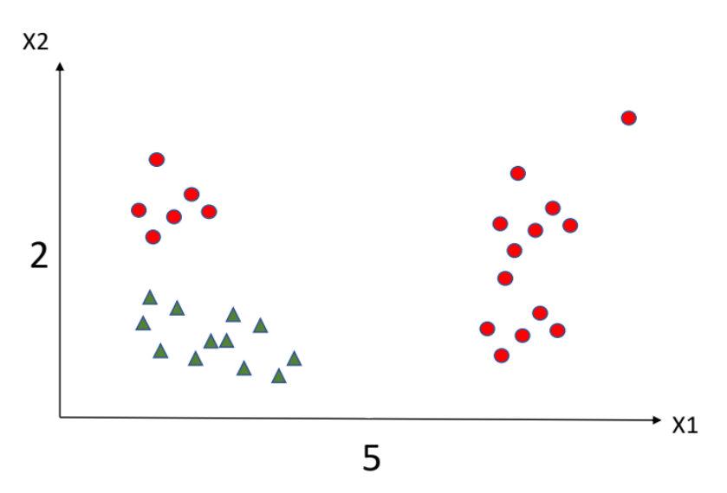
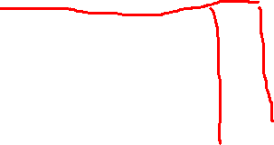
Decision Tree
How to find the decision boundary
Even though the data is not linearly separable.

Slide 12
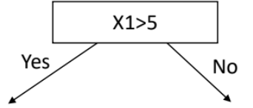
First Split
Red 100%, Blue 0%
Red 33%, Blue 66%
Impure Node

Slide 13
Second Split
Red
X2>2
Red 100%, Blue 0%
Red 0%, Blue 100%

Slide 14
Decision Boundary
Red
X2>2
Yes
No
Red
Blue

Slide 15
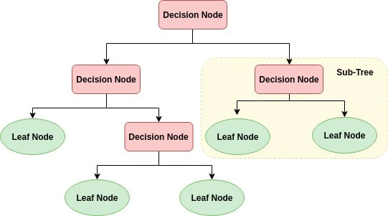
Decision Tree components

Slide 16
Decision Tree
We choose a feature and try to divide the space into regions based on that feature
And continue to divide these regions into smaller regions until we successfully separate the classes.
But how to choose which feature is best to split first?

Slide 17
Gini Impurity
We can use a way to quantify the quality of each split
Gini Index quantifies the quality of Impure Nodes
small value indicates that a node contains predominant observations from a single class.
Gini Index for Decision = Weighted average of Leaf impurities

Slide 18
Imputity index
High impurity ➔ bad

Slide 19
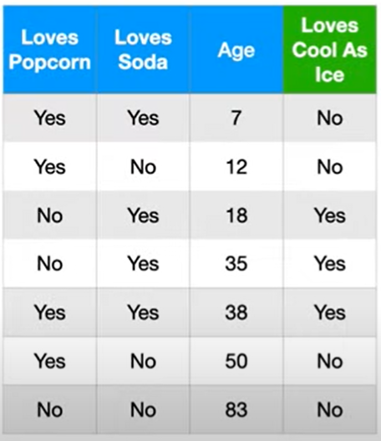
Let’s Try an Example

Slide 20
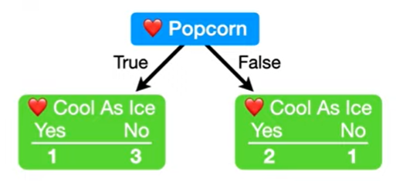
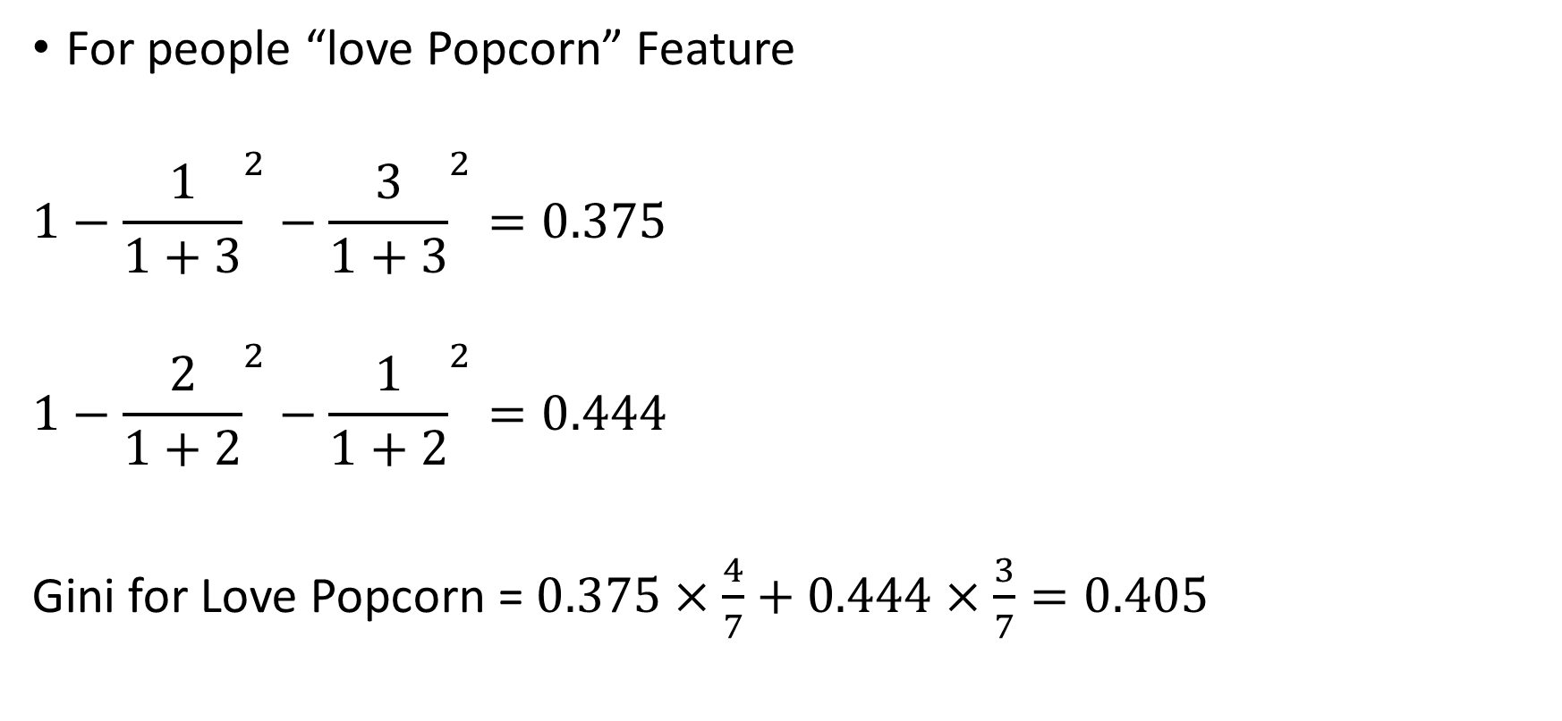
Finding the First Split
For people “love Popcorn” Feature
$$1−{\frac{1}{1+3}}^{2}−{\frac{3}{1+3}}^{2}=0.375$$
$$1−{\frac{2}{1+2}}^{2}−{\frac{1}{1+2}}^{2}=0.444$$
Gini for Love Popcorn = $0.375×\frac{4}{7}+0.444×\frac{3}{7}=0.405$

Slide 21
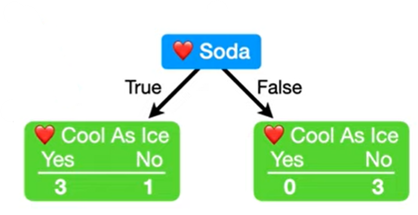
Finding the First Split
For people “love Soda” Feature
Gini for Love Soda = 0.214

Slide 22
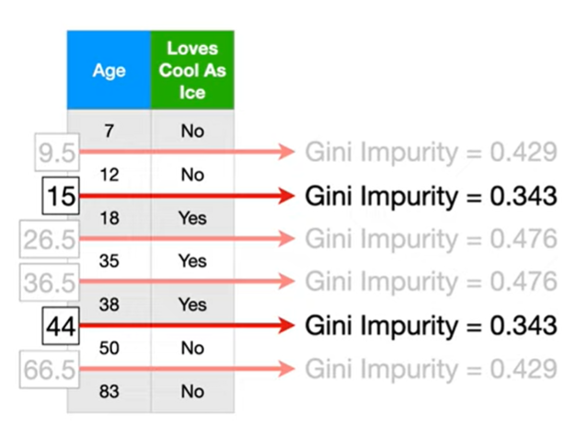
Finding the First Split
What can we do about Age?
First we sort the rows by age.
We calculate the average of each 2 adjacent ages.
We calculate impurity for each average.
We choose the lowest Impurity

Slide 23
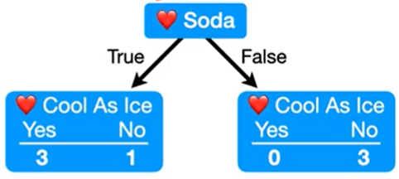
Finding the First Split
We can See that “love Soda” is the best for the first split.
We can see that the left node is impure
So we need to split it further

Slide 24
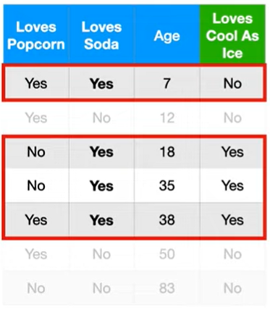
Finding the Next Split
Rows to be considered

Slide 25
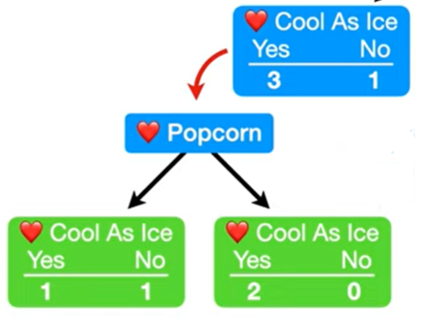
Finding the Next Split
Gini Impurity for this split is 0.25

Slide 26
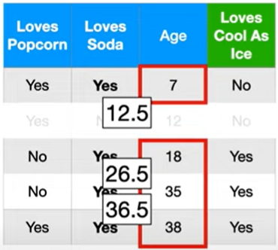
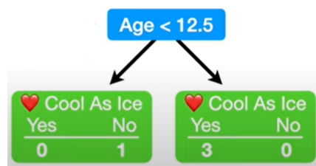
Finding the Next Split
Doing the same for age
Finding the right age split
Gini Impurity for this split is 0

Slide 27
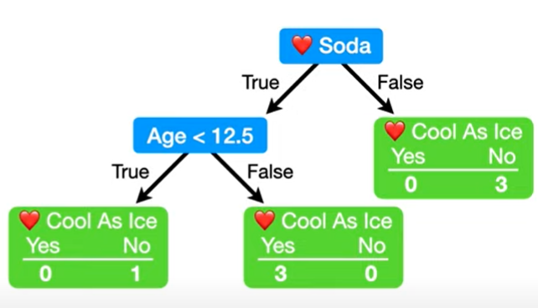
Finding the Next Split

Slide 28
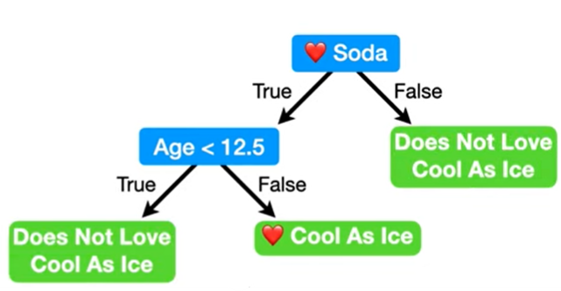
Resulting Decision tree

Slide 29
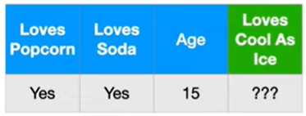
Let’s Predict Based on this Tree

Slide 30
Disadvantages of Decision Tree
Greedy approach of choosing splits don’t yield the global optimum tree structure.
As the branching goes deeper, you get exponentially less data.
Can over fit easily
Look at the tree we just made
In the very left leaf node
Only 1 observation made it to this node.

Slide 31
How to prevent Overfiting
Specify a maximum tree depth.
Pruning: cutting sections of the tree
Minimum number of observation per leaf
So this tree is more realistic
The predictions will be probabilities of classes

Slide 32
Advantages
Trees are very easy to explain to people. In fact, they are even easier to explain than linear regression.
Some people believe that decision trees more closely mirror human decision-making than do the regression and classification approaches seen in previous chapters.
Trees can be displayed graphically and are easily interpreted even by a non-expert (especially if they are small).

Slide 33
Assessment of Classification Models

Slide 34
Classification
Test data = 100 example ➔class_0 = 98 , class_1 = 2(imbalanced data)
Acc = 98%
Test data = 1000 ➔ 990 , 10
----------------------------------------------------------------------------------------------
Recall = من كل كل المصابين الموديل جاب كام واحد
Precision= من كل الى الموديل قال عليه مصاب في كام واحد فعليا مصاب

Slide 35
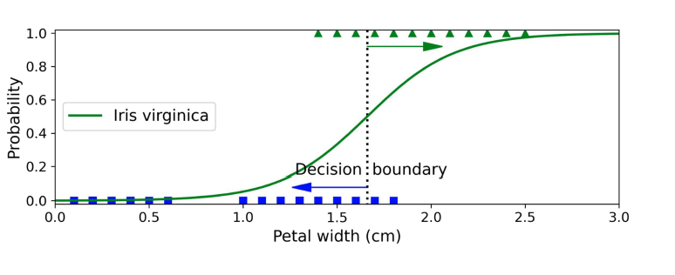
All green is 12 true is 9
All blue is 15 true is 13
Acc = (9+13)/(15+12)
Prec (green) = 9/11
Rec (green) = 9/12
--------------------------------------------
Prec(blue) = 13/16
Rec (blue) = 13/15

Slide 36
Assessment of Classification Models
We talked about accuracy: percentage of examples that are classified correctly by your model.
Sometimes, accuracy is not sufficient to describe the model.
Consider a diagnostic tool that uses a machine learning model to tell that person X has a disease Y.
In this scenario, we are interested in two types of errors:
If X has the disease, what is the probability that the device say that X does not have it.
If X does not have this disease, what is the probability that the device will say that he has it.
Consider an accident detection alarm
If the alarm is on, what is the probability that there’s an accident
If there’s an accident, what is the probability that the device will not detect it.

Slide 37
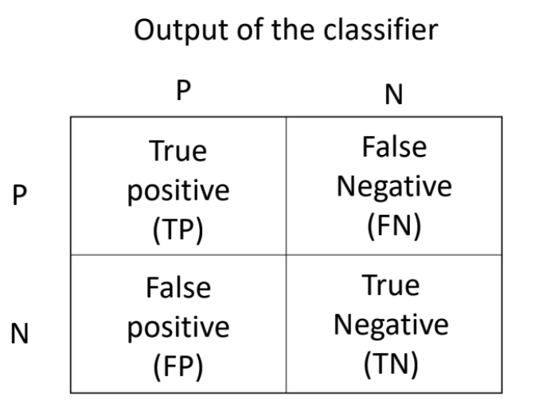
Confusion Matrix

Slide 38
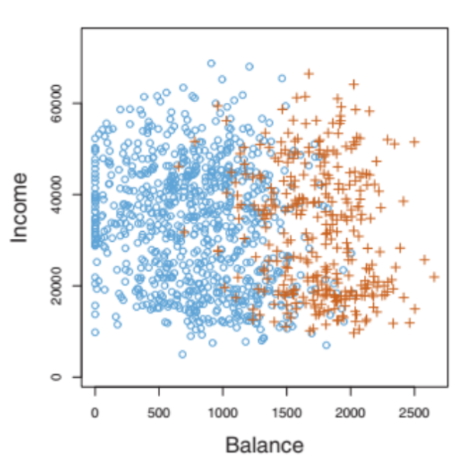
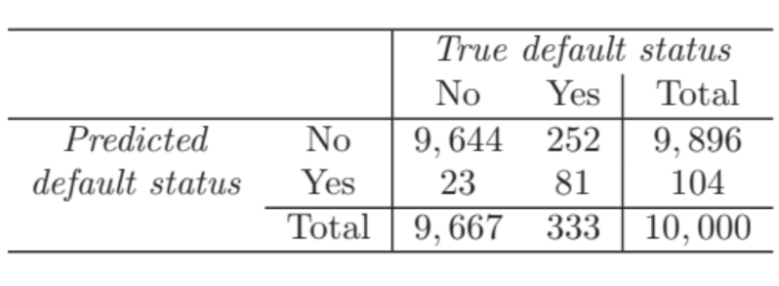
Confusion Matrix
Example

Slide 39



Recall, Precision and F1 score
Recall (other names sensitivity and probability of detection and true positive rate) :
Precision
F1 score: harmonic mean of precision and recall

Slide 40
When to use
Example: we try to classify apples and oranges
In case of in balanced data
Accuracy: how many apples and not apples correctly classified from total.
In case of in imbalanced data we should use either
Precision: of all observations classified as apples how many are correct.
Recall: of all observations truly apples how many are correct.
F1 score: balance between precision and recall.

Slide 41
When to use
Recall: In case we want to reduce False negatives
If we want to detect poisonous apples we don’t want to miss any poisonous apples.
Precision: In case we want to reduce False positives
If we want to determine if a stock is a good investment or not, it’s ok to miss a few good investments but we don’t want to falsely classify a good investment.
F1 score: In case we want to optimize both metrics without prioritizing one over the other.

Slide 42




Sensitivity and Specificity
Common metrics in biology
Sensitivity (same as recall)
Specificity (True negative rate)

Slide 43
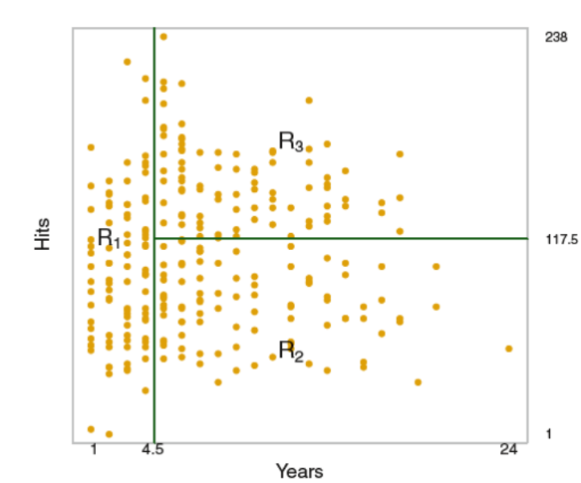
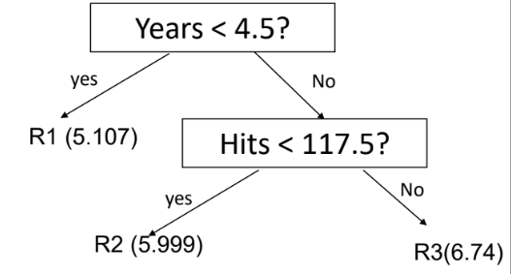
Decision Tree Regression
Can be used for Regression
Instead of Gini Impurity we use Residuals
Predictions are the average of Regions in leaf node

